Slide 1

Blockchain
Level 1 - Awareness
Public – Company Confidential – Customer Confidential – Sensitive

Slide 3







Capgemini Consulting, le leader français de la transformation digitale
Une force de frappe de 900
consultants en France et de
3 600 dans le monde
70 vice presidents au service des entreprises pour les accompagner dans leur transformation
80% des entreprises
du CAC 40 sont nos clients
Depuis 5 ans, un partenariat de recherche exclusif avec le MIT sur la transformation digitale
Une présence concentrée sur 16 pays
Allemagne, Autriche, Belgique, Chine, Espagne, Etats-Unis, Finlande, France, Grande-Bretagne, Hong Kong, Inde, Norvège, Pays-Bas, Singapour, Suède, Suisse
Des accélérateurs digitaux et des méthodologies innovantes : l’Accelerated Solutions Environment, Fast&Furious et la Data Farm
Une appartenance à un Groupe de 180 000 collaborateurs, l’un des leaders mondiaux du conseil, des services et de l’infogérance

Slide 4

Une expertise reconnue en stratégie IT
Cloud Transformation
Agile & DevOps
Digital Workplace
Industrialization & Automation
Cloud
Infrastructure
Platform
Multi-speed
IT Operating
Model
Cyber Security
IT Service Management
Lean IT
Technology Innovation
Applications
Transformation
IT PMI
Digital IT Strategy
IoT/Blockchains/Robotics
IT Cost Reallocation
Digital Architecture
Technology Innovation Process
Complex Pgm Mgt
Applications Rationalization
Big Data & Analytics
Transversal offers
IT as a Service
Data Management

Slide 6

La promesse d’une révolution…
Open protocol
Design
Timeframe
Major impacts
Examples
World Wide Web
First users: custodians of data -> academic institutions,
governments
Email, search engines, web pages, API’s and other internet/cloud services (SaaS, PaaS, IaaS)
TCP/IP internet network (completed by HTTP, DNS, ARP,…)
Information exchange
1990
Blockchain, the NEXT GAME CHANGER?
Blockchain & cryptocurrency
Value
exchange
2009
Internet of value First users: custodians of value -> banks, financial institutions
Payment, micro-payment, smart contract, smart property, IoT
Blockchain enables numerous use cases and could replace bank centralized platforms and systems of authority

Slide 7

…débutée en 2009 par un mystérieux inventeur…

Slide 8

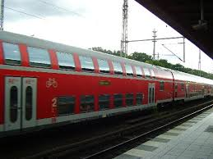
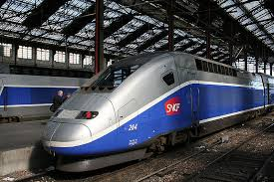
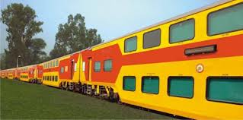
Bitcoin et blockchain, deux notions à ne pas confondre
Cryptocurrency
‘Blockchain’ as the track
‘Currency’ as the Coach
While currently the track and coach are bundled in most offerings, a separate ownership may be of great interest in the future

Slide 10




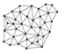

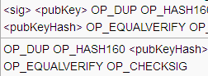
Une définition et des principes pour comprendre la Blockchain
La blockchain est une technologie de base de données distribuée qui peut être utilisée pour diverses applications telles qu'un registre pour les transactions de pièces numériques
No Intermediary
Pseudonimous and public
Open source
Distributed
Irrevocable transactions
Secured

Slide 11

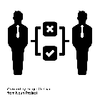




Deux typologies de Blockchain pour deux utilisations différentes
Public blockchain
Vs.
Private blockchain
Anyone can read / write on the database
Only authorised entities can read / write on the database
Accessibility
Slow
Fast(er)
Speed
Proof of work
Proof of Stake
Pre-approved participants
Security
Anonymous / Pseudonymous
Public identity
Identity
Base assets
(e.g.: bitcoins for bitcoin’s blockchain)
Whatever asset
Assets

Slide 12

“No intermediary” : Exemple du paiement à l’international
Country A
Country B
PAYER
PAYEE
Blockchain
10 – 60 min
Payer’s bank
Payee’s bank
Payment
system
Payment
system
2 / 4 days
TRADITIONAL SYSTEM
Correspondent bank
Correspondent bank

Slide 13
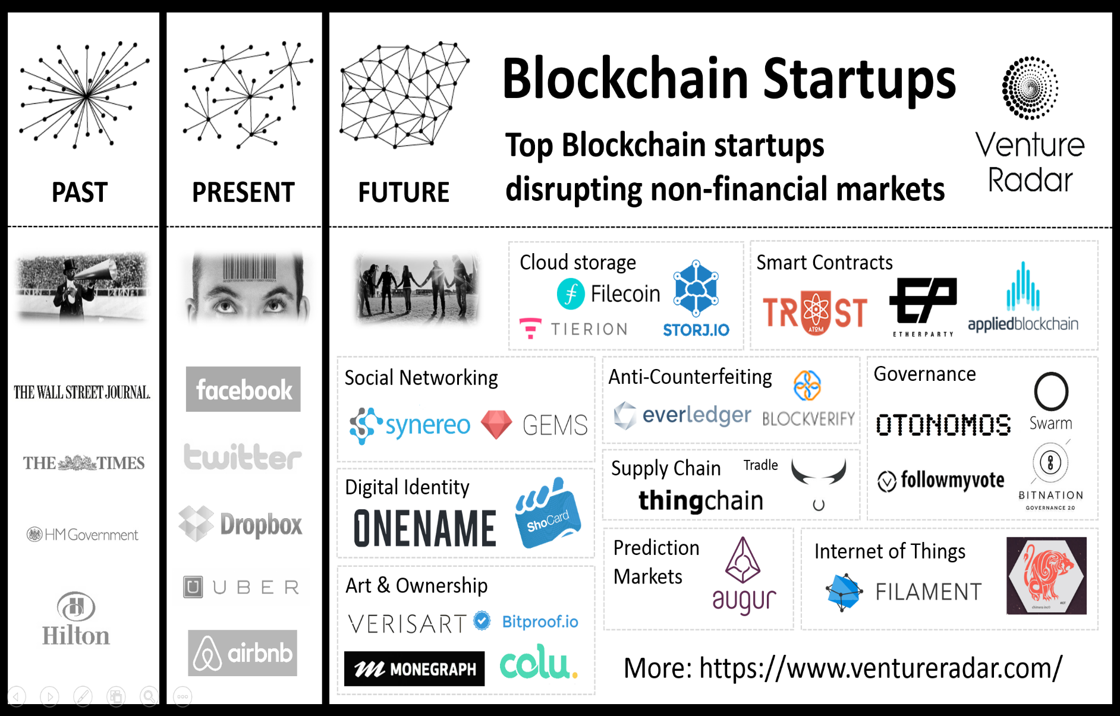
“Distributed”

Slide 14



Exemple d’une transaction bitcoin sur la blockchain bitcoin
1
A wants to send money to B
2
The transaction is represented online as a ‘block’
3
The block is broadcast to every party in the network
?
?
?
?
?
4
Those in the network approve the transaction is valid
5
The block then can be added to the chain, which provides an indelible and transparent record of transactions
6
The money moves from A to B
✓
✓
✓
✓
FT
✓

Slide 15
Focus sur les smarts contracts
Regular contracts
Smart contracts
Definition
Words on paper
Software program: Code
Execution
Interaction between human and/or objects
Possible punishment
Definition can be interpreted (trials)
Program execution
No interpretation possible
Autonomous
Audit
Manual data recollection
Real time
Immutable
Smart contracts leverage blockchain immutability feature to enforce digital, autonomous contracts that allow many folds productivity gains on some specific contractual arrangements

Slide 18
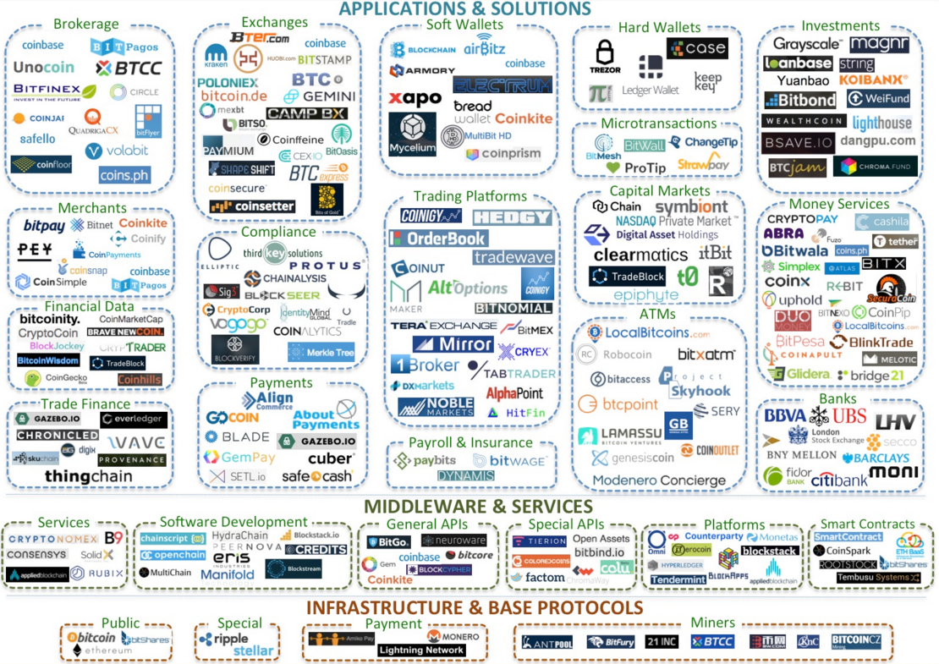
Plus d’un 1 milliards de $ investi en 2016
Source: startupmanagement.org
/

Slide 19

























A travers des consortiums, des alliances ou seuls, les services financiers se sont positionnés comme leaders des initiatives Blockchain sur 2015-2016
1
2
3
4
5
€
Experiments
by internal teams & first patent applications
Experiments, investment and partnership with Ripple
Country initiatives
Experiments by market infrastructures
Large interbanking initiatives
Examples:
Netherlands: Ondina /
exchange
R3 CEV: More than 40 banks signed in order to work together on standardisation and experimentation, especially on securities trading
Securities trading / post-trade reporting
Financial Institutions:
Belgium: considering « instant payments » on blockchain
Bitcoin blockchain to replace clearing & settlement system
…
Open Ledger project:
The Linux Foundation, Digital Assets, IBM, R3, Intel, London Stock Exchange Group, Mitsubishi UFJ Financial Group, IC3, and VMware target to create open ledgers
Singapore: payments experimentation
PATENT applications:
10 blockchain-related patents filed by Bank of America in July 2014, and Goldman Sachs deposited a patent application for a Blockchain-based wallet solution
Identifying common use cases, KYC

Slide 20


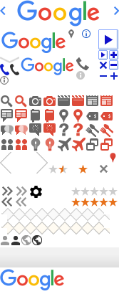







Plusieurs exemples de uses cases non financiers
Insurance
Energy
@
GAFA
Use of Smart Contracts technology for transacting a natural catastrophe swap
Peer-to-peer energy transaction and distributed energy control
Google and Apple are interested in Ripple as a substitute of Visa
Blockchain-based smart energy monitoring for Public
Blockchain-as-a-service sandbox for developers
Ethereum-based flights insurance using smart contracts
Blockchain-based energy exchange system allowing source traceability
One partnership with Stratum and Deloitte
Anti-fraud ledger for diamonds
Insurances benefit from smart contracts and Blockchain to lighten their documents and accelerate their functioning
Blockchain allows communities to share energy and make possible the traceability of consumed energy
GAFA are still discrete regarding Blockchain probably designing their proper solutions

Slide 21





Ou cross-secteurs
Human Resources
Legal functions
Use of Blockchain to validate and certify data about employees
Blockchain-based trustworthy voting system
Blockchain-based system for alumni diploma certification
Blockchain-based system for digital creations
authenticity certificate and ownership
Resume authentication experimentation
Human Resources can benefit from the trust and certification provided by Blockchain, dodging fraud
Digital certification can be a problem solver for legal issues

Slide 22
La question qu’il fallait se poser avant : “Est-ce que j’ai réellement besoin d’une Blockchain ?”
1
Do I need a database?
NO
Go for a regular file storage system
YES
2
Are there multiple writers?
NO
A regular relational database will suffice
YES
3
Is disintermediation needed?
NO
A centrally validated database is enough
YES
4
Am I working in a low trust environment?
Multiple databases to which users can subscribe will work just as well
NO
YES
5
Is there significant transaction interaction?
A Master/Slave database replication setting will probably do the job
NO
YES
There is potentially a Blockchain
use case to dig into !

Slide 23







Nos réalisations 1/2 : Définir la stratégie Blockchain d’un grand groupe financier
A major French multinational banking and financial services company
Universal banking model, addressing 31 million customers in 66 countries
The Client
Construction of a position paper defining the Group 2017-2019 internal roadmap on Blockchain
Identify and agree on the scope of the project
Present Blockchain trends, major actors and perspectives
Identify and cartography all internal initiatives, experimentations and actors already linked to the Blockchain technology (16 initiatives, 33 experts within 8 divisions were mapped)
Assess Group maturity inside its ecosystem to identify possible areas of application for the Bank (4 main applications were identified and prioritized)
Co-construct a Group Position summarizing the high-stakes opportunities and major challenges for the Group (use cases to launch, communication strategy, recruitment policy, etc.) via the creation of an internal editorial committee
Focus on the IT convictions of the group regarding the impact of Blockchain on infrastructure and architecture
Communicate and infuse the recommendations within the Group
Scope
Following its publication of an IT white paper on several innovations topics, the Bank is looking to better define what strategy it should adopt on the Blockchain technology
The IT Group division is looking to determine how to be better identified as the major internal referent on the topic

Slide 24
Nos réalisations 2/2 : Mise en place d’un POC pour un assureur Contexte et solution
Avant la Loi Hamon
Après la Loi Hamon
Demande de résiliation par LR | Gestion des résiliations
Demande de résiliation | Gestion des résiliations
50 à 80%
Intermédiaire
Client
Intermédiaire
Nouvel assureur
Client
Repêchage/Traitement
Traitement
Assureur
Ancien assureur
Cas de résiliation :
Résiliation à date d’échéance
Par extinction de l’objet (déménagement, vente de voiture…)
Loi Chatel*
Cas dé résiliation :
Cas précédents
Loi Hamon : Pour les produit automobile et MRH, possibilité de résiliation des contrats à tout moment dès le terme de la première année
*loi n°2008-3 du 3 janvier 2008
Impacts pour les assureurs
Evolution des processus
Déport des charges et de coûts
Augmentation du volume de résiliation
Evolution des circuits des flux entrants avec un envoi dirigé plus vers les sociétés d’assurances que vers les intermédiaires
Fin des pratiques de repêchage
Frais d’envoi à la charge des assureurs (LR : 3,4€, LRAR : 4,4€)
Concentration du traitement des actes de résiliation au sein des assureurs
Simplification des formalités qui ne sont plus à la charge du client
Effet d’aubaine en fonction des campagnes marketing des différents assureurs

Slide 25


Nos réalisations 2/2 : Mise en place d’un POC pour un assureur Typologie de la solution
Répartition
Multi-transaction
La Blockchain sera répartie entre toutes les parties prenantes afin d’assurer :
Le schéma suivant présente un exemple de multiples transactions entre assureurs. Nous n’avons pas un broadcast des transactions vers des nœuds/assureurs qui ne seraient pas concernés
La confidentialité des données et transactions
Les flux seront point à point entre le nouvel assureur et l’assureur tenant.
Assureur 1
Assureur 8
Assureur 2
Assureur 3
Assureur 7
Assureur 4
Ainsi un autre assureur ne pourra pas avoir connaissance du volume de résiliation ni de leurs détails
Assureur 6
Assureur 5

Slide 27

Mes convictions
Companies must filter the signal through the noise, and focus on identifying relevant use cases beyond the hype
Faced with uncertainty, companies must experiment through careful testing and limited-scope implementation of blockchain POCs
Private, permissioned blockchain is the go-to configuration for our large cap clients
Smart contracts will be the killer app of blockchain in years to come
First mover advantage matters

Slide 28
4 freins majeurs à la généralisation de la Blockchain
Involvement and positioning of the regulator regarding Blockchain solutions & use-cases
Interoperability of developing
solutions
Comparative evaluation of solution from a pure technology and security perspective
Detailed impact analysis of the various use cases & prioritisation of developments

Slide 29
Thank you for your attention!

Slide 30





Niveaux d’interaction pour une Banque digitale basée sur un modèle ouvert d’API
Customers
Staff
Partners
IoT
Interactions
Identification / authentification
Multi
-
devices
Digital
Workplace
Apps Store
Application
services store
Customized content
Data
management
management
visualization
Process
Real-time access
Security
Omnichannel
IA
-
API Management
Data & Applications
Applications and services
Data
Servicisation
Valorisation
Temps-réel
Analysis
24/7
Verification
Application Services
Big
Data
Data lake
Blockchain/SC
Cloud Infrastructure

Slide 31
Macro-vision of a Blockchain integration
Example: a simple 2-nodes Blockchain
Our convictions
Information System
Private Blockchain, based on PoS, avoid PoW consensus (CPU intensive)
Decouple IS applications from the Blockchain infrastructure
Use standard technologies and reuse internal development workforce
Think automation as soon as possible (devops, containers…)
Blockchain monitoring
Activity
Security
Technical
Blockchain Mgt
Permissions management
Assets and Smart Contracts
App1
App2
Intermediation
POC Server
Node 1
API
Node 2
API
Application
UI
Container
Blockchain node
Blockchain

